Slide 1
Gas Exchange

Slide 2
By the end of this Smart Lesson you should be able to:
1. | Explain what gas exchange is.
2. | Describe how alveoli speed up gas exchange.
3. | State the direction of gas exchange for oxygen and carbon dioxide.
4. | Explain how inhaled and exhaled air differs.

Slide 3
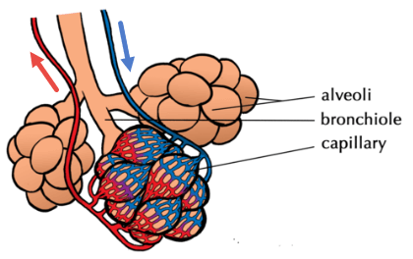
Quick recap: At the very end of each bronchiole are bunches of little air sacs (like bunches of grapes) called alveoli (singular= "alveolus").
The alveoli are the place where gas exchange occurs.

Slide 4
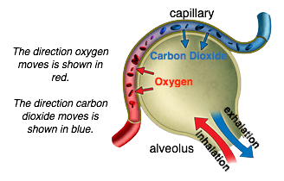
Gas exchange I
Gas exchange is where oxygen that we breathe in is moved into the bloodstream for cells to take up and carbon dioxide is removed from the bloodstream into the lungs, so that it can be breathed out.
Alveoli are very thin, so that oxygen and carbon dioxide can quickly and easily move through them, into or out of the blood.

Slide 5
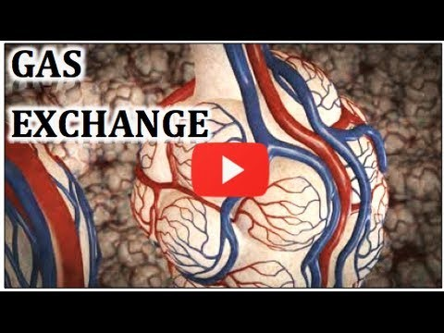

Slide 6
Gas exchange with Oxygen I
Oxygen that we breathe in, eventually makes it to the end respiratory system structure: the alveoli.
Once you have breathed in and oxygen has reached your alveoli, oxygen then diffuses into red blood cells in capillaries (blood vessels) that surround the alveoli. These red blood cells deliver the oxygen throughout your body. There is an extensive capillary network surrounding the alveoli to speed up gas exchange.

Slide 7
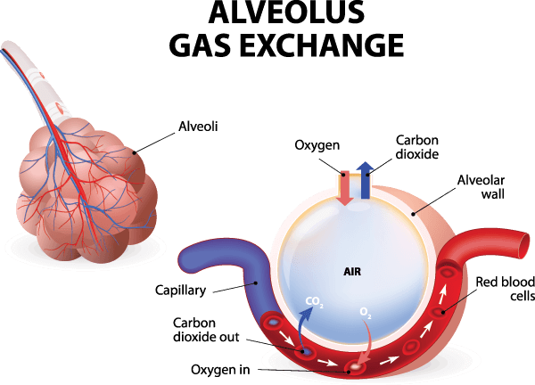
How is gas exchange so efficient?
To speed up the diffusion (form of movement) of oxygen, the membrane of an alveolus is moist and very thin - only one cell thick! It also is divided into alveoli to produce a huge surface area. The total area of the lungs for gas exchange is roughly the size of a tennis court!
The membrane between the alveolus and capillary is called the respiratory surface.
Once the oxygen reaches the tissue cells where it is needed, it is released from the red blood cells and travels through the thin capillary walls to the tissue cells by diffusion.

Slide 8
Gas exchange with Carbon Dioxide
Carbon dioxide in the bloodstream diffuses in the opposite direction to oxygen, entering the alveoli to travel through the respiratory system, where it is exhaled.
Too much carbon dioxide is toxic for our body. This is the primary reason why we dispose of it!

Slide 9
Have you ever wondered why it is dangerous to breathe into and from a bag?
Or why, if you sealed yourself into an airtight box or cupboard, you would eventually suffocate?
This is because, when we exchange gases, we remove some oxygen from the air we inhale, and replace it with carbon dioxide that we are getting rid of and exhaling.

Slide 10

This simply means, if there is no fresh source of air.
We gradually use up all oxygen in the air, causing the carbon dioxide content of the air to increase.
A plastic bag over the head can kill you! Why? Because the oxygen levels get so low within the bag, that the cells in our body cannot make energy to survive!

Slide 11
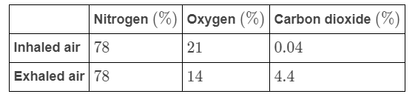
Air Composition I
Because of gas exchange, inhaled and exhaled air is made up of different amounts of oxygen and carbon dioxide.
Below is a table showing the approximate composition of inhaled and exhaled air:

Slide 12
Air Composition II
Inhaled air has the same amounts of oxygen and carbon dioxide as the atmosphere surrounding us.
Exhaled air has different amounts of oxygen and carbon dioxide to inhaled air because we remove oxygen from the inhaled air when we do gas exchange, and add carbon dioxide when it diffuses into the alveoli from the capillaries. It also has a higher level of water vapour.

